Slide 1
Standard User – Manage Contract Relationships (including Amendments) and Management Tab features
February, 2013

Slide 2

Learning Objectives
Upon completion of this course you will be able to:
Display the Relationship sub-tab on the Management tab
Define the type of Relationships
Select the contract for the Relationships
View the contents of the Related document
Understand other features of the Management tab
Understand the Contract Amendment process

Slide 3

Manage Contract Relationships
Contracts can have relationships to other documents. For example, these may be:
  Documents that are referenced within the contract
  Amendments
  Documents that have similar terms, or
  Master agreements whose terms apply to a sub-agreement.
ECM helps you manage these relationships.

Slide 4
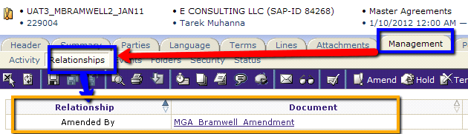
Display Relationships
With a contract open in the Contract Editor, the document relationships are displayed from the Management tab.
Click the Management tab > Relationships sub-tab.
The list of related documents is displayed.
  NOTE: If no document relationships have already been established, nothing will be displayed.
Notes:
NOTE TO TRAINERS: To show a contract with a relationship, create an amendment to a contract and execute the amendment. This will automatically create the relationship as shown above.

Slide 5
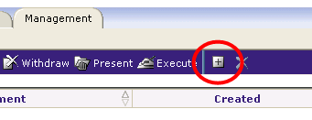
Relationships Sub-tab
You can establish a relationship to any other online document.
Click the Add Relationships icon on the far right of the main, blue toolbar.
The Add Relationship dialog box is displayed.

Slide 6
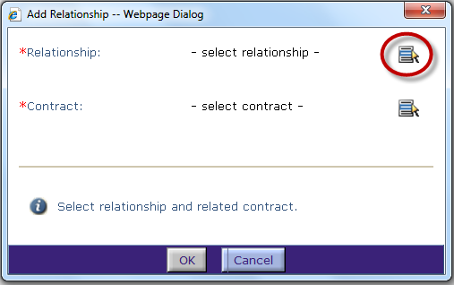
Add Relationships Dialog Box
Here you can define the type of relationship in each case.
To select a Relationship, click the Select icon on the far right of dialog box.
The Select Relationship dialog box is displayed.

Slide 7
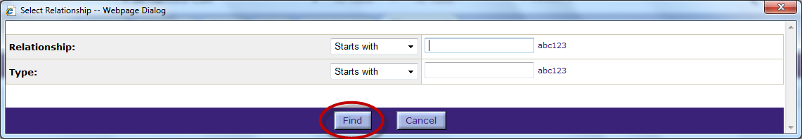
Select a Relationship
Enter a Relationship name or partial name.
Or, leave all fields blank to display a list of all available relationships.
Click Find.
The list of relationships is displayed.

Slide 8
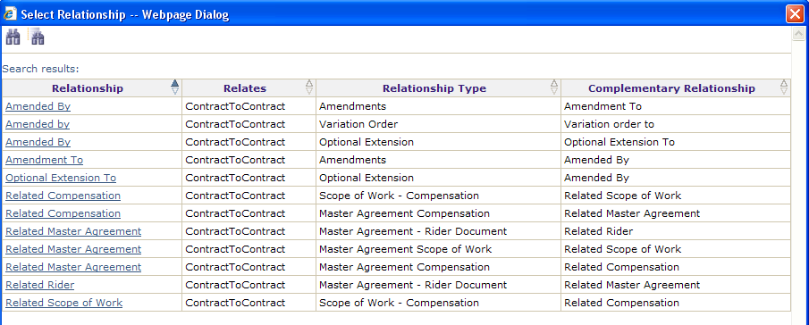
Select a Relationship, cont.
Select the type of relationship for these documents and click in the row to highlight it.
  For this example we selected the “Amendment To” relationship.

Slide 9
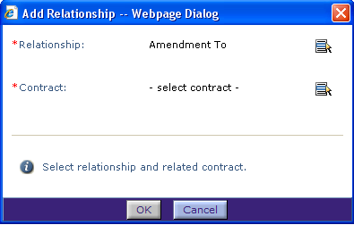
Select a Contract
The relationship is added to the Add Relationship dialog box.
To select the Contract for the relationship, click the Select icon at the far right of the field.
The Select Contract dialog box is displayed.

Slide 10
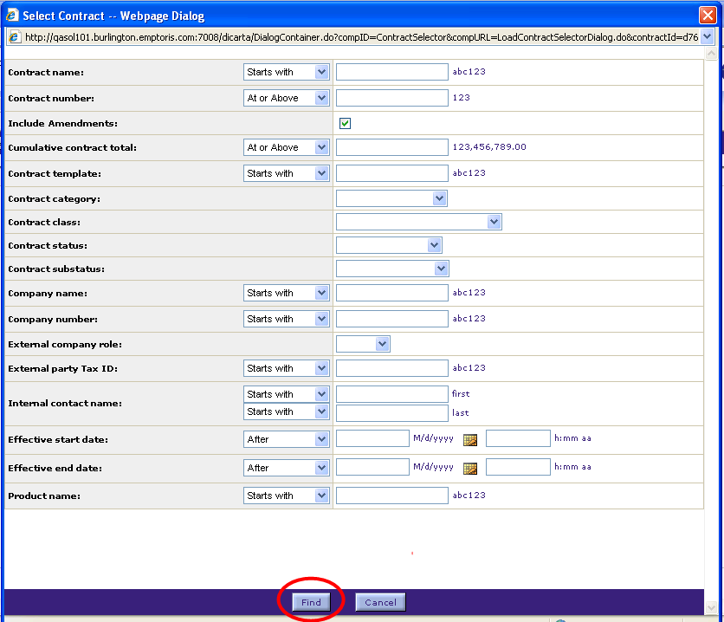
Select a Contract, cont.
Enter a name or partial name in any of the fields to search for the contract.
Or, leave all fields blank to display a list of all available contracts.
Click Find. The list of contracts is displayed.

Slide 11
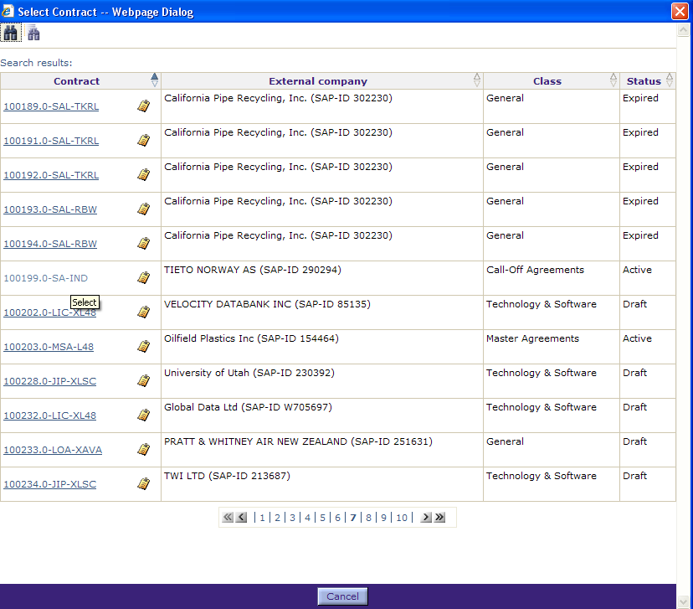
Select a Contract, cont.
Navigate to the page that contains the contract name using the chevron arrows and page numbers.
Click the Contract Name hyperlink.
The contract is added to the Add Relationship dialog box.

Slide 12
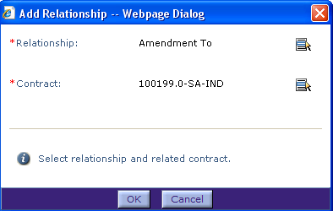
Add a Relationship
Now that both the Relationship type and Contract have been selected, click OK to establish this relationship.
The document is added to the Relationships list.

Slide 13
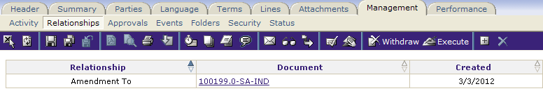
View a Related Document
The display shows that the current contract is “related to” the listed document.
You can click on the document name hyperlink to open and view the contents of the related document.

Slide 14
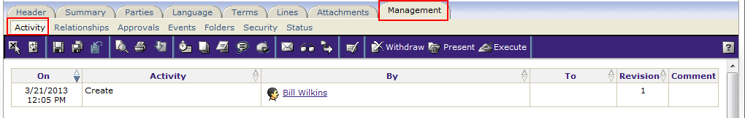
Management Tab – Other Features
There are several other sub-tabs of the Management tab in the Contract Editor:
Activity: Gives a history of the major activity for this contract. This can also be seen from the “View Activity Log” option from the “gear” icon under Actions in My Tasks.
Approvals: For defining who is to approve the contract. Usually this is made read-only or hidden entirely from contract workers.
Security: For defining the security on the contract. Usually this is hidden from contract workers.
Folders: The contract can be placed in folder(s) here.
Status: This shows the current status of the contract and a history of sub-status values
(Relationships and Events are discussed elsewhere)

Slide 15
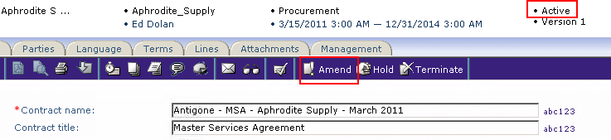
Contract Amendment Process
Without ECM, an amendment is a new, separate document that says what is changing from the original contract (document) that it supercedes
With ECM, a Contract Amendment is implemented through a Relationship. An amendment is linked inextricably to the original contract, and pulls in Term values and other details.
An Amendment can be created for a contract with a status of Executed, Active, or On Hold. When such contracts are opened in the Contract Editor, the Amend link is available. You can also go to the Home Page and use New > Amendment, then search for the contract to be amended. The user requires the permission to create amendment contracts.
You should never use the same Contract Template for both contracts and amendments. I.e., you should have a special set of Amendment templates, and the Suitability boxes for those templates should rule out their use for contracts

Slide 16
Contract Amendment Process (cont.)
You can use the Add Clause function in the amendment contract (from the Language Tab → Word Editor) to pick clauses in the original contract that need to be changed. Those clauses get copied into the amendment contract for modification. After changes are made, clicking on the Impacts function will confirm that changes were made.
When an Amendment Contract itself changes to a status of Executed (or Active: exercise for the reader), the Amendment language is added to the bottom of original contract's language. At the same time, Term values that are updated in the Amendment are copied to the original contract.
Having both the original and amended contract language together is very powerful, but customers tend to either love or hate it. Sales people usually love it, but governments and providers often prefer to have no change to the original contract from an amendment.

Slide 17

Questions?

